Slide 1
Single Link List

Slide 2
Linked List
A
B
C
∅
Head
A linked list, or one-way list is a linear collection of data elements called nodes, where linear order is given by means of pointer.
A linked list is a series of connected nodes
Each node contains at least
A piece of data (any type)
Pointer to the next node in the list
Head: pointer to the first node
The last node points to NULL
node
A
data
pointer
Notes:
Add example from pg: 115

Slide 3
Linked List
Now let’s consider our previous list, used with an array i.e. 2, 6, 8, 7, 1. Following is the figure which represents the list stored as a linked list.
We also have a pointer current to point to the current node of the list. We need this pointer to add or remove current node from the list.
In the linked list, the current is a pointer and not an index as we used while using an array.
2
6
8
7
1
∅
Head
Current

Slide 4
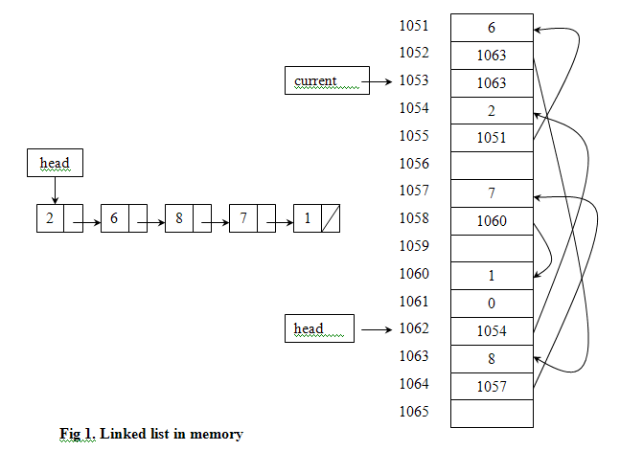
Representation of Link List in Computer Memory

Slide 5
Inserting a new node
Possible cases of Insertion
Insert into an empty list
Insert at beginning
Insert at end
Insert at Position
But, in fact, only need to handle two cases
Insert as the first node (Case 1 and Case 2)
Insert in the middle or at the end of the list (Case 3 and Case 4)

Slide 6
Inserting to the Beginning
head
93
48
17
142
head
Allocate a new node
Insert new element
Have new node point to old head
Update head to point to new node

Slide 7
Inserting to the End
head
48
17
142
//
93
//
Allocate a new node
Insert new element
Have new node point to null
Have old last node point to new node
Update tail to point to new node

Slide 8
Inserting to the Position
head
17
48
142
//
//
93
142
Allocate a new node
Insert new element
Go to the node that should follow the one to add
Have that node point to the new node
Have new node point to node next node to the found node

Slide 9
Searching a Linked List
Searching refers to finding a particular ITEM in the data.
Binary search algorithm can not be applied to sorted link list since there is no way indexing the middle element in the list. This property is one of the main drawbacks in using a linked list as a data structure

Slide 10
Deleting a node
Possible cases of Deletion
Delete from beginning
Delete from end
Delete in middle
There are two special cases
Delete first node
Delete the node in middle or at the end of the list

Slide 11
The Scenario
head
6
4
17
42
head
6
4
17
42
head
4
17
42
head
4
17
42

Slide 12
Structure
struct node node
{
int info;
struct node* next;
}*start;
A
data
pointer

Slide 13
Creating nodes
void Create(int num)
{ int data;
struct node *temp;
temp=(struct node *)malloc(sizeof(struct node));
for(int i=1;i<=num;i++)
{
if(start==NULL)
{
cout<<"enter data for node"<<i<<": ";
cin>>data;
temp->info=data;
temp->next=NULL;
start=temp;
}
A
Next
NULL

Slide 14
else
{
cout<<"enter data for node"<<": ";
cin>>data;
InsertEnd(data);
}
}
}

Slide 15
Insert at end
void InsertEnd(int data)
{
struct node* ptr,*tempnode;
ptr=start;
while(1)
{ if(ptr->next!=NULL)
ptr=ptr->next;
else
break;}
tempnode=(struct node*)malloc(sizeof(struct node));
tempnode->info=data;
tempnode->next=NULL;
ptr->next=tempnode;}
Next
B
Next
A
NULL

Slide 16
Insert at Beginning
void InsertBegin( int data)
{ struct node* tempnode;
tempnode=(struct node*)malloc(sizeof(struct node))
tempnode->info=data;
temonode->next=start;
start=tempnode;
}
A
Next
Next
Next
D
Next
B
C
Null
E
Next
tempnode

Slide 17
Insert at n^{th} position
void InsertPos(int data,int pos)
{
struct node*tempnode,*ptr;
ptr=start;
for(int i=0;i<pos;i++)
{
if(ptr==NULL)
{cout<<"Invalid position";
return;
}
ptr=ptr->next;
}
A
Next
Next
Next
D
Next
B
C
E
Next

Slide 18
if(ptr->next==NULL)
InsertEnd(data);
else
{tempnode=(struct node*)malloc(sizeof(struct node));
tempnode->info=data;
tempnode->next=ptr->next;
ptr->next=tempnode;
}
}

Slide 19
Traversing a Link List
Traversal means “visiting” or examining each node.
Simple linked list
Start at the beginning
Go one node at a time until the end

Slide 20
Traversing
void PrintList()
{
node *ptr=head;
while(ptr!=NULL)
{
cout<<ptr->data<<" ";
ptr=ptr->next;
}
cout<<endl;
}

Slide 21
Deletion from End
void del_End()
{
struct node *pnode, *ptr;
ptr=start;
while(ptr->next!=NULL){
pnode=ptr;
Ptr=ptr->next;
}
if(ptr==start)
{
start==NULL);
free(ptr);}
else
{ pnode->next=NULL;
free(ptr);
}
}
A
Next
Next
Next
D
Null
B
C

Slide 22
Deletion from Beginning
Void del_Begin()
{
node *temp;
temp=start;
start=temp->next;
free(temp);
}
A
Next
Next
Next
D
Next
B
C

Slide 23
Deletion from Position
void del_Pos()
{
int pos,I;
node *temp,*temp1;
cout<<“Enter postion”;
cin>>pos;
while(i<pos-1)
{
temp=temp->next;
i++;
}
temp1=temp->next;
temp->next=temp1->next;
free(temp1);
A
Next
Next
Next
D
Next
B
C

Slide 24
Variations of Linked Lists
Circular linked lists
The last node points to the first node of the list
How do we know when we have finished traversing the list? (Tip: check if the pointer of the current node is equal to the head.)
A
B
C
Head

Slide 25
Array versus Linked Lists
Linked lists are more complex to code and manage than arrays, but they have some distinct advantages.
Dynamic: a linked list can easily grow and shrink in size.
We don’t need to know how many nodes will be in the list. They are created in memory as needed.
In contrast, the size of a C++ array is fixed at compilation time.
Easy and fast insertions and deletions
To insert or delete an element in an array, we need to copy to temporary variables to make room for new elements or close the gap caused by deleted elements.
With a linked list, no need to move other nodes. Only need to reset some pointers.

